Slide 1
Information and
Communication Technologies
University Of Science and Technology -Houari Boumediene
Aktouche Ismail Rayane
Regoub Anes
Meziani Ayoub
Sahraoui Amani
Boukezzata Nihad

Slide 2
Table of contents
01
02
03
04
What is ICT, information and communications technology or technologies? and
technologies included in ICT
ICT vs IT and ICT components that include hardware, software, middleware, data…
The importance of ICT in businesses and the challenges that it creates
ICT, the digital age and digital divide and finally some examples of technologies related to ICT

Slide 3
Table of contents
01
02
03
04
What is ICT, information and communications technology or technologies? and
technologies included in ICT
ICT vs IT and ICT components that include hardware, software, middleware, data…
The importance of ICT in businesses and the challenges that it creates
ICT, the digital age and digital divide and finally some examples of technologies related to ICT

Slide 4
Table of contents
01
02
03
04
What is ICT, information and communications technology or technologies? and
technologies included in ICT
ICT vs IT and ICT components that include hardware, software, middleware, data…
The importance of ICT in businesses and the challenges that it creates
ICT, the digital age and digital divide and finally some examples of technologies related to ICT

Slide 5
Table of contents
01
02
03
04
What is ICT, information and communications technology or technologies? and
technologies included in ICT
ICT vs IT and ICT components that include hardware, software, middleware, data…
The importance of ICT in businesses and the challenges that it creates
ICT, the digital age and digital divide and finally some examples of technologies related to ICT

Slide 6

01
Information and communications technology and
its technologies.

Slide 7
What is ICT (information and communications technology or technologies
ICT, or information and communications technology (or technologies), is the infrastructure and components that enable modern computing. Among the goals of IC technologies, tools and systems is to improve the way humans create, process and share data or information with each other. Another is to help them improve their abilities in numerous areas, including business; education; medicine; real-world problem-solving; and even leisure activities related to sports, music, and movies.
There is no single, universal definition of ICT because the technologies, devices and even ideas related to ICT are constantly evolving. However, the term is generally accepted to mean all devices, networking components and applications. When combined, these help people and organizations interact in the digital world.

Slide 8
Technologies included in ICT:
1
Landline telephones, radio and television broadcast
2
The internet, internet of things, metaverse, virtual reality and social media are also part of ICT
3
unified communications systems and mobile communication networks. like 5G/6G, Web3, and quantum computing.
4
Cloud computing services, video conferencing and collaboration tools, infrastructure, component, or device that enables communications, data sharing, and global connectivity between humans and machines.

Slide 9

02
ICT vs IT and
ICT Components

Slide 10
ICT vs. IT
The acronym ICT is sometimes used synonymously with IT. However, ICT is generally used to represent a more comprehensive list of all components related to computer and digital technologies.
IT is more about managing the technologies related to information, and its various technical aspects, including software, hardware, and networking. IT management does not include considerations of telecommunications devices and technologies while ICT does. IT can be considered a subset of ICT.

Slide 11

Components of ICT
The list of ICT components is exhaustive and continues to grow. Some components, such as computers and telephones, have existed for decades. Others, such as smartphones, digital TVs and robots, are more recent entries. ICT components include the following:

Slide 12

Hardware(devices)
Software
Middleware

Slide 13
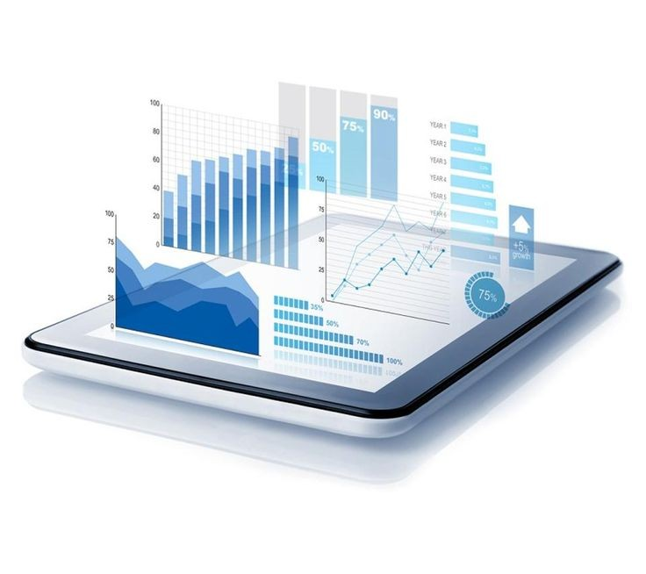
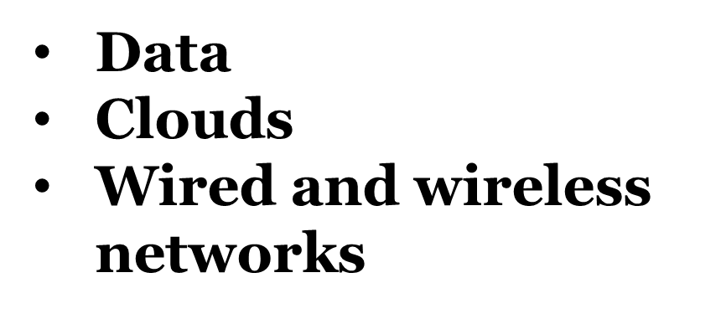

Slide 14
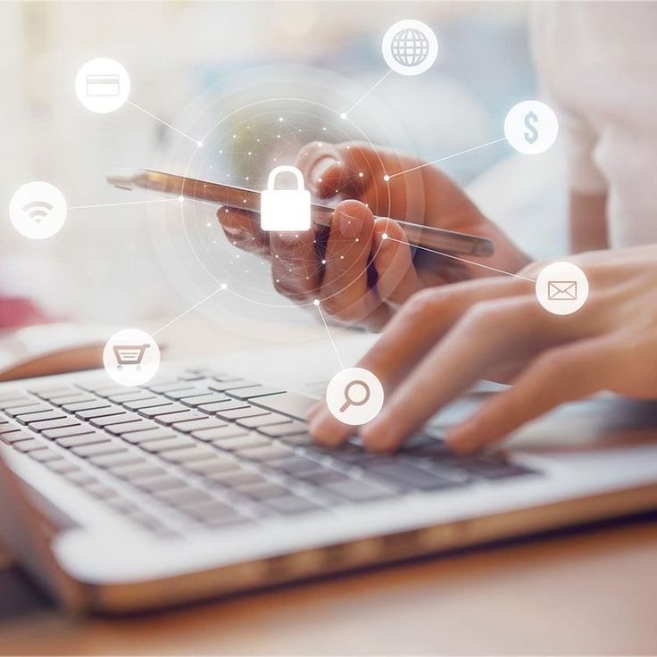
Information security and governance policies
Communication protocols and interfaces

Slide 15

03
The importance of ICT in businesses and the challenges that it creates

Slide 16

ICT importance
for businesses
For businesses, advances within ICT have brought a slew of cost savings, opportunities and conveniences. They include the following:
Highly automated businesses processes that have cut costs.
The big data revolution, where organizations are turning the vast trove of data generated by ICT into insights that drive new products and services.
ICT-enabled transactions such as internet shopping and telemedicine and social media that give customers more choices in how they shop, communicate and interact.

Slide 17
Challenges ICT creates
Its many benefits notwithstanding, ICT has also created problems and challenges for organizations, individuals and society. The digitization of data, the expanding use of the high-speed internet and the growing global network together have created new opportunities for crime. Increasingly, bad actors leverage these opportunities to hatch new schemes to gain unauthorized access to enterprise or government systems. They do so to steal money, intellectual property or private information.
Many cybercrimes are also aimed at disrupting systems that control critical infrastructure and, ultimately, creating widespread chaos and panic.
Developments in ICT have also brought new automation technologies and robots that sometimes displace workers, especially workers involved in repetitive, low-value tasks. In some cases, ICT has let more people limit their face-to-face interactions with others, creating or exacerbating social issues such as trolling, cyberbullying, isolation, loneliness and depression.

Slide 18
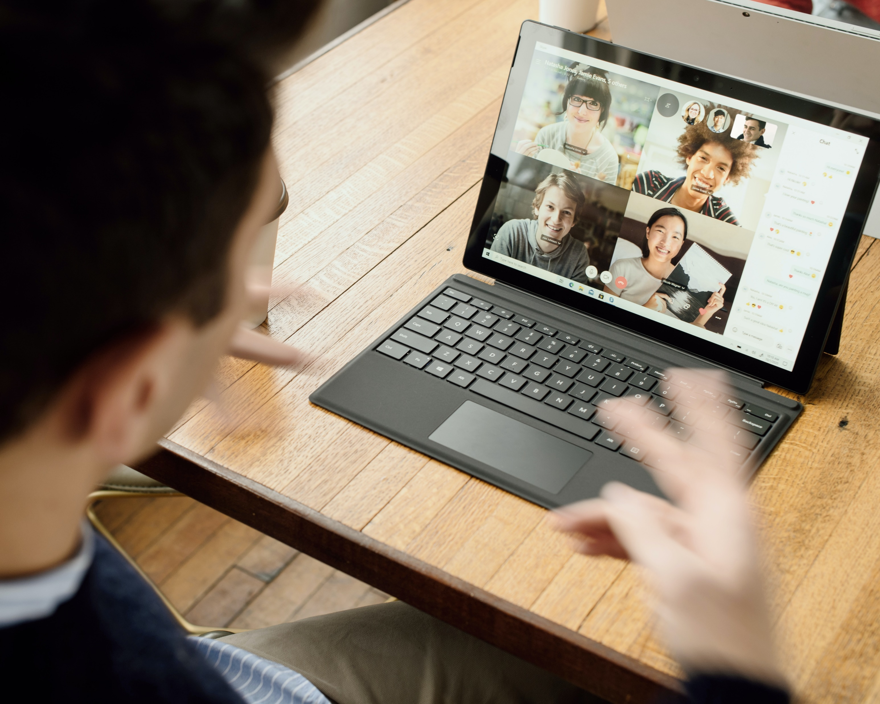
04
ICT the digital age and digital divide and finally some examples of technologies related to ICT

Slide 19
Digital age
Digital divide
ICT has connected the world enabling instant communication and access to vast amount of information and it did transform businesses, marketing, and innovation, growth and competitiveness.
The digital age is marked by rapid technological, fostering innovation in various sectors.
ICT capabilities aren't evenly distributed, due to geographical and economical reasons, and disparities in education and technological literacy contribute to a digital divide. Affordability of deices and internet services can limit the access for ICT.
The digital divide can lead to social exclusion.

Slide 20
Digital age
Digital divide
ICT has connected the world enabling instant communication and access to vast amount of information and it did transform businesses, marketing, and innovation, growth and competitiveness.
The digital age is marked by rapid technological, fostering innovation in various sectors.
ICT capabilities aren't evenly distributed, due to geographical and economical reasons, and disparities in education and technological literacy contribute to a digital divide. Affordability of deices and internet services can limit the access for ICT.
The digital divide can lead to social exclusion.

Slide 21
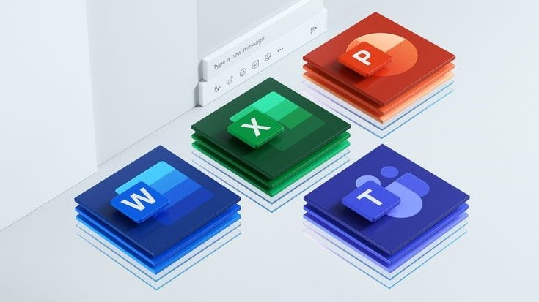
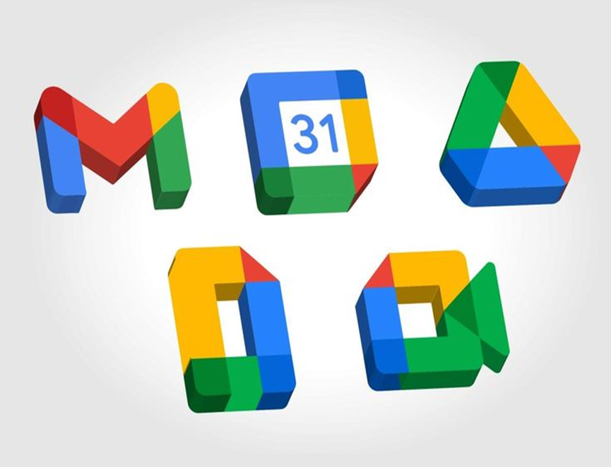

Some examples of technologies related to ICT

Slide 22
Microsoft Tools:
Microsoft Office 365
Microsoft Team
Azure
Visual Studio
One Drive

Slide 23
Google services:
Google Search
Gmail
Google Drive
Google Maps
Google Sheets, Docs And Slides

Slide 24
Git and GitHub:
Git
GitHub
Repositories
Branching
Pull Requests

